Slide 1
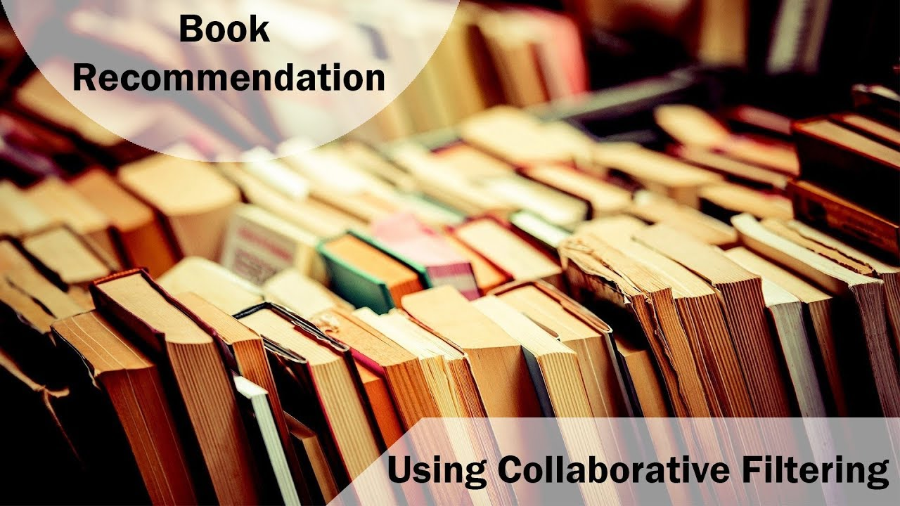
Books Recommendation System Project
Presented By:-
Mr. Pravin Shende
Mr. Vishal Patil
Mr. Maniratnam Ande
Guided By:-
Mr. Karthik Muskula
Mrs. Dhanyapriya Somasundaram

Slide 2
Project Objective:
Content Information:
The Book-Crossing dataset comprises 3 files.
Users Contains the users. Note that user IDs (User-ID) have been anonymized and map to integers. Demographic data is provided (Location, Age) if available. Otherwise, these fields contain NULL-values.
Books Books are identified by their respective ISBN. Invalid ISBNs have already been removed from the dataset. Moreover, some content-based information is given (Book-Title, Book-Author, Year-Of-Publication, Publisher), obtained from Amazon Web Services. Note that in case of several authors, only the first is provided. URLs linking to cover images are also given, appearing in three different flavours (Image-URL-S, Image-URL-M, Image-URL-L), i.e., small, medium, large. These URLs point to the Amazon web site.
Ratings Contains the book rating information. Ratings (Book-Rating) are either explicit, expressed on a scale from 1-10 (higher values denoting higher appreciation), or implicit, expressed by 0.
Generate the features from the dataset and use them to recommend the books accordingly to the users.

Slide 3



INTRODUCTION TO RECOMMENDATION SYSTEM
Recommendation system is an information filtering technique, which provides the information as per users interest.
In current situation in each types Business operation are using recommendation systems
Types of recommendation system : -
1.Popularity based recommender system
2.Content based recommender system
3.Collaborative recommender system
4.Hybrid recommender system
Exaples of Companies who are using these Recommedation System Techniques.
Facebook : “ People you may kow ”
Instagram: “Suggested for You!”
Linkedin: “ you may also like this .”

Slide 4
DETAILS ABOUT RECOMMENDATION SYSTEM :
A recommender system, or a recommendation system is a subclass of information filtering system that provide suggestions for items that are most pertinent to a particular user.
Recommender systems are particularly useful when an individual needs to choose an item from a potentially overwhelming number of items that a service may offer.
TYPES OF APPROACH
Collaborative Filtering
Collaborative filtering is based on the assumption that people who agreed in the past will agree in the future, and that they will like similar kinds of items as they liked in the past.
Hybrid Recommendations
Most recommender systems now use a hybrid approach, combining collaborative filtering, content-based filtering, and other approaches.
Content Based Filtering
Content-based filtering methods are based on a description of the item and a profile of the user's preferences.

Slide 5
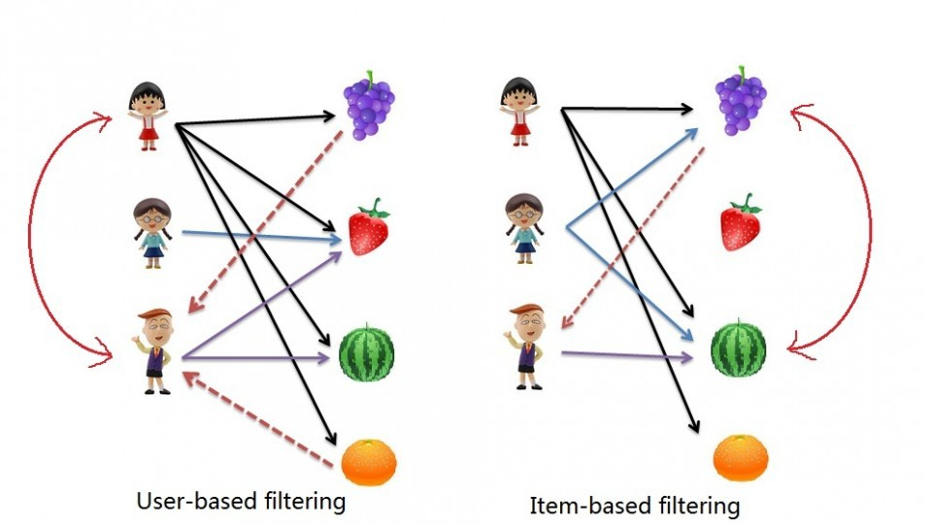
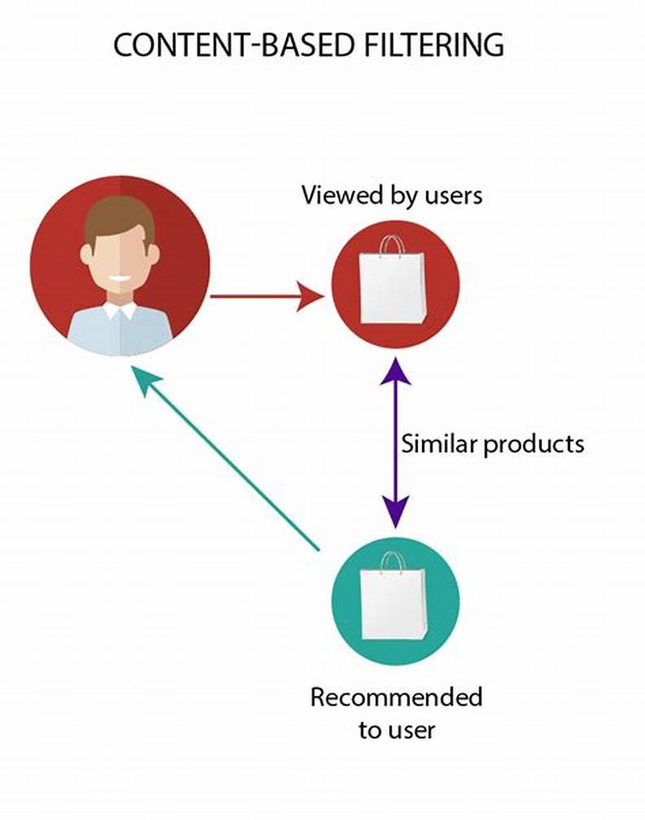
Types of filtering Techniques shown in visual format:
Types of Collaborative Techniques:
Content Based Filtering Technique:
Based on the image let assume A purchased all 4 fruits, B purchased only strawberry and C purchased strawberry as well as watermelon. Here A & C are similar kinds of users because of this C will be recommended Grapes and Orange as shown in dotted line.
Here the only difference is that we see similar items, not similar users like if you see grapes and watermelon you will realize that watermelon is purchased by all of them but grapes are purchased by Children A & B. Hence Children C is being recommended grapes.
They are different in that they provide recommendations based on books articles and the words included within them (mostly tags). If a person reads an books that includes the terms Machine learning and Data Science, it’s likely that the same user enjoys reading additional books that include these terms.

Slide 6
PROJECT FLOW
These are the steps which we will follow while building forecasting model:
EDA & Data Visualization
Model Building
Model Evaluation
Model Deployment
Using different metrics , we will evaluate different models & try to reach one for best one.
Using Streamlit library , we will Deploy our model for Service purpose.
EDA will help to understand the nature, trend , duplication, missing values in the dataset.
For recommendation system there are many models like collaborative , content based we have applied all these techniques on the given all 3 datasets.

Slide 7
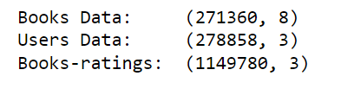


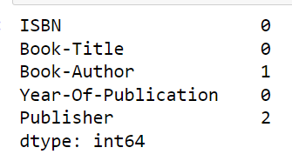
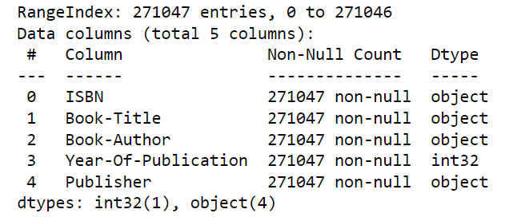
Data set Information:
These are columns in the Books Dataset:
Dimesions of All 3 Datasets:
These are columns in the Users Dataset:
These are columns in the Ratings Dataset:
Books Dataset Contains Following no. of Null values in columns:
After Preprocessing Books Dataset contains following information:

Slide 8
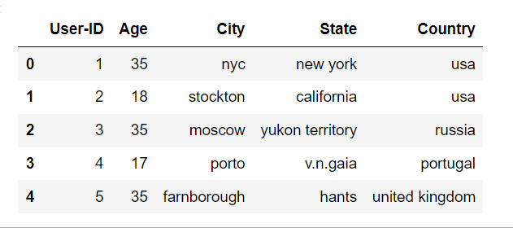
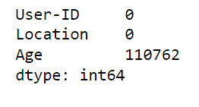
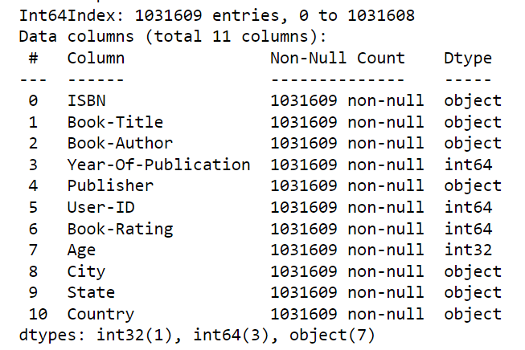
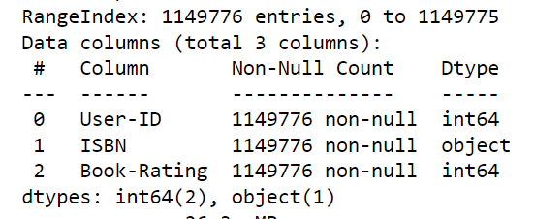
Data set Information:
Sample of Processed Users Dataframe:
Sum of Null Values in Users Dataset:
Information of Merged Dataframe:
Information of Ratings Dataset:

Slide 9
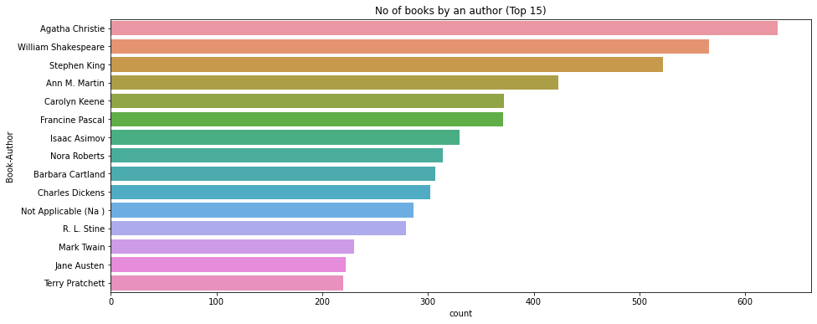
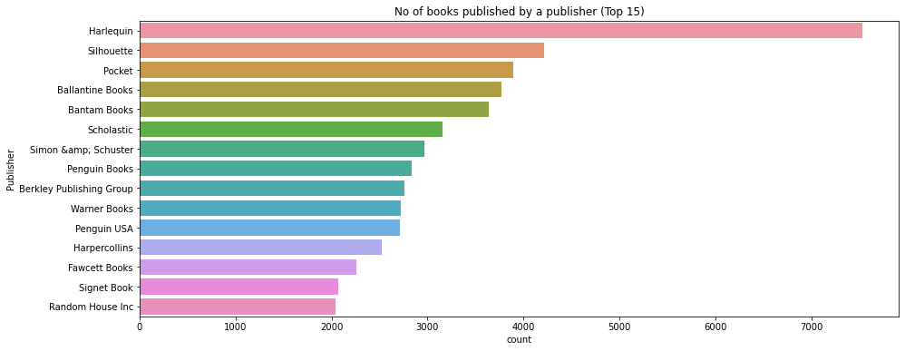
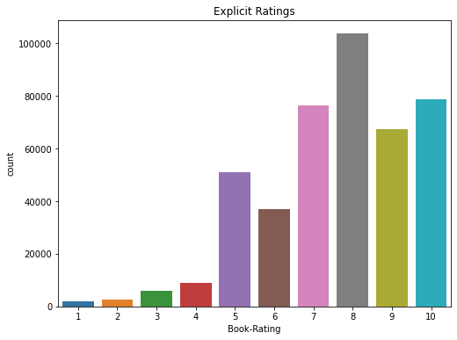
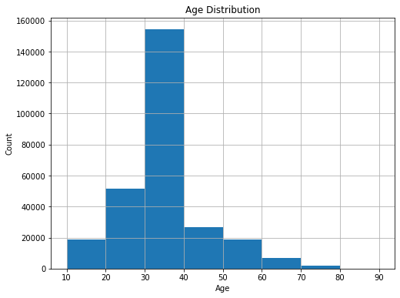
Data Visulization:
This Graph shows the top 15 Publishers who have published maximum No. of Books.
This this graph shows the top 15 Authors who have written maximum Books
This plot shows the Comparision of Rating Count
This Image shows the Age distribuition of the Readers.

Slide 10
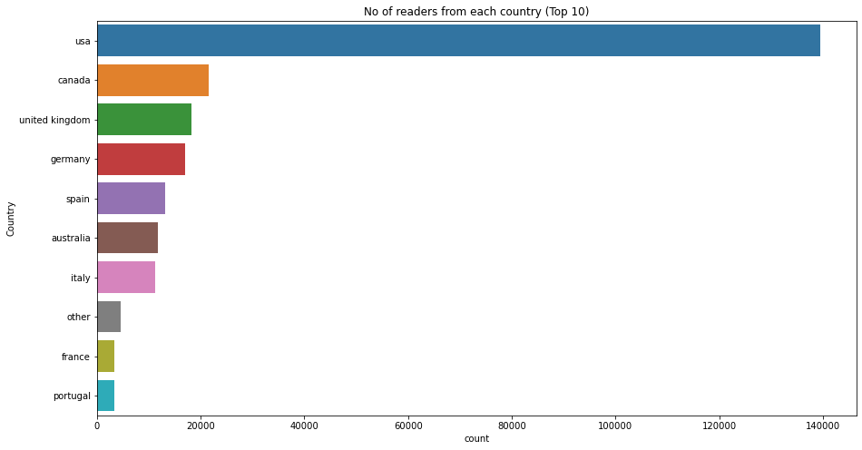
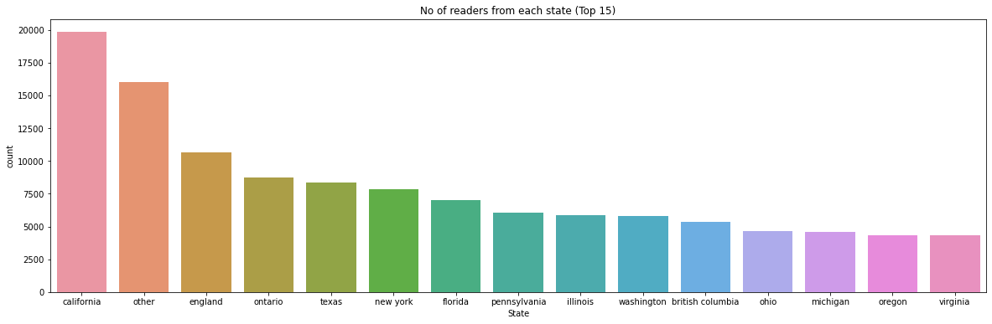
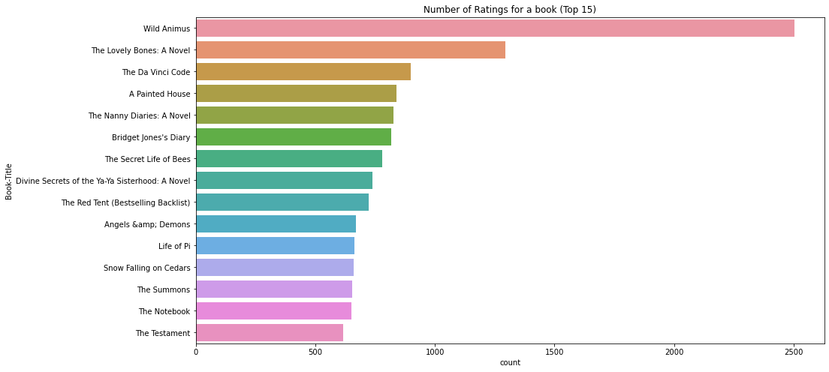
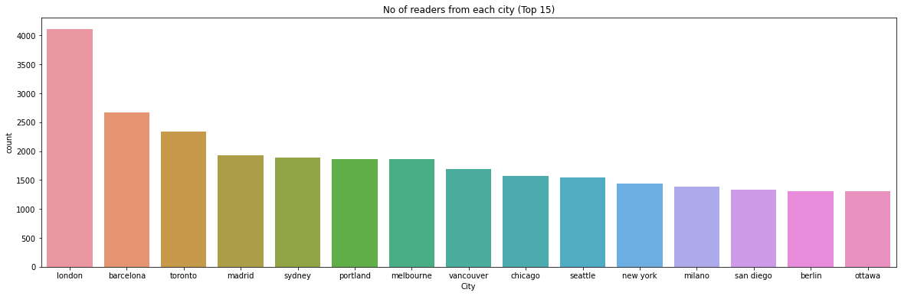
Data Visulization:
This bar graph shows the total no. of readers from top 15 states of Usa Country.
- California, England, Ontario etc.
are top among the 15 states.
This Bar graph shows the No. of Reader from each Country.
Top 3 countries Acc. To count are:
.Usa
. Canada
.United Kingdom
These are top 15 cities according to the count of total no. of readers .
London, Barcelona, toranto, madrid etc. are top among the 15 cities.
These are top 15 Books acco. To Rating that they have got.
Wild Animus has got the highest ratings.

Slide 11
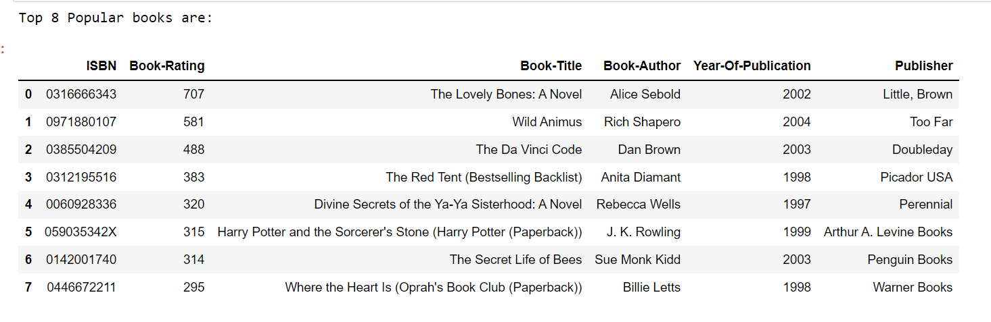
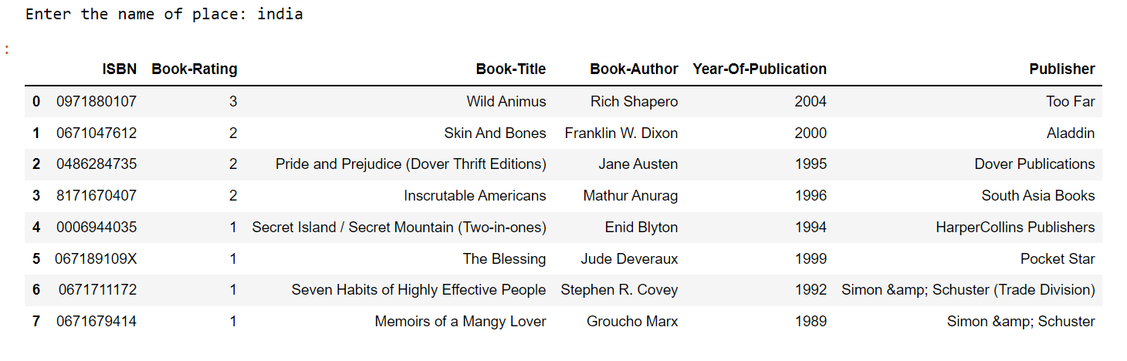
Recommendations Using Different Techniques:
1. Popularity Based (Top In whole collection)
2. Popularity Based (Top In a given place)
Above Dataframe shows Top 8 books are recommended according to the Place we have entered.
Here, top 8 books from India are shown which have got the higest Book Rating.
Here , Top 8 books are recommended according to the highest Rating they have got in the whole collection of the books .

Slide 12

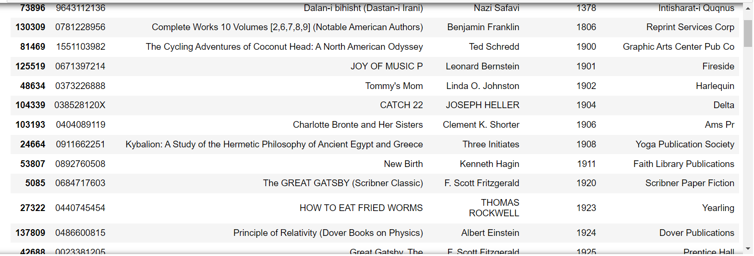
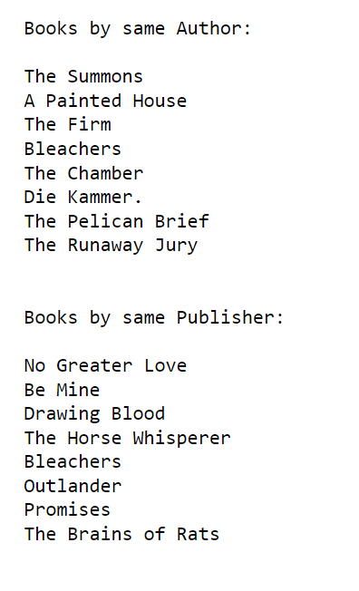
Recommendations Using Different Techniques:
3. Books by same author, publisher of given book name
4. Books popular Yearly
Above Dataframe Shows the one Book which is top rated in Each Year.
Example: 1) JOY OF MUSIC P is the most popular book in year 1901.
Above Frame shows the top 8 highest popular books written by the same author and publisher of The Testament book author.

Slide 13
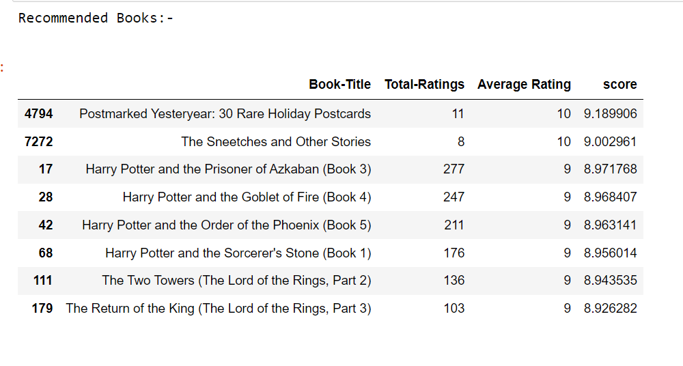
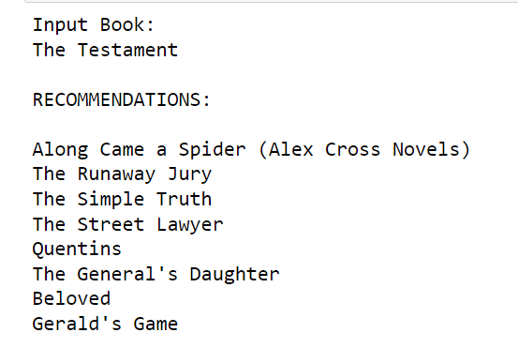
Recommendations Using Different Techniques:
5. Average Weighted Ratings¶
6. Collaborative Filtering (User-Item Filtering)
NOTE: Just having highest ranking No. is not important , that book should be Hightest rated by the highest No. of the readers also .
So we have used Average Weighted concept here .
And acco. To this , these are top 8 highest popular books .
Above result show the books recommended by using the collaboration filtering technique.

Slide 14
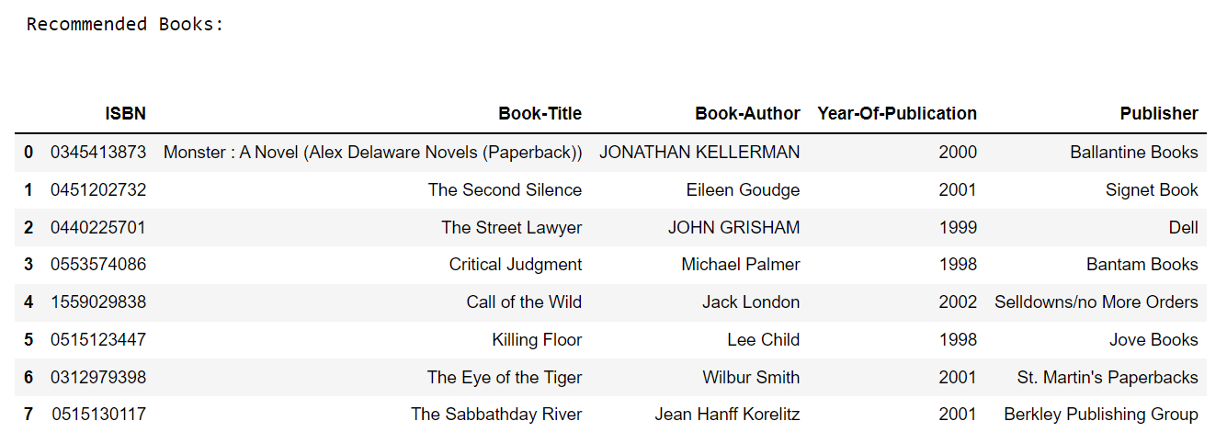
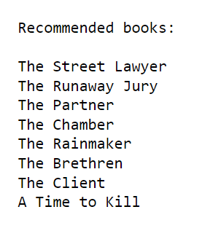
Recommendations Using Different Techniques:
7. Correlation Based
8. Nearest Neighbours Based
Above result show the books recommended by using the . Nearest Neighbours technique.
Above result show the books recommended by using the correlation based technique.

Slide 15
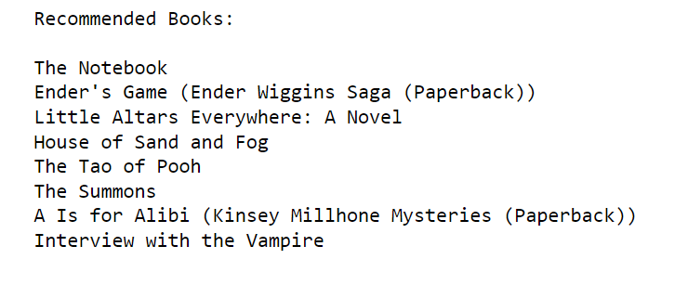
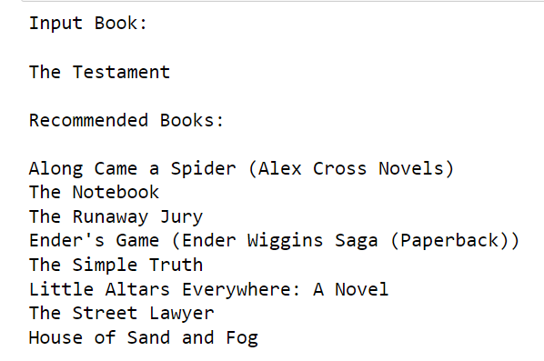
Recommendations Using Different Techniques:
9. Content Based
10. Hybrid Approach (Content+Collaborative) Using percentile
In this type of recommendation system, relevant items are shown using the content of the previously searched items by the users.
Here content refers to the attribute/tag of the product that the user like.
In Hybrid Approch both collaboration and content based approach are simultaneously used.

Slide 16
Dificulties faced while making project:
There were many missing values in the all the 3 datasets so we have to fill it using appropriate methods.
For eg. In Books dataset , in books-authors and publisher columns , we filled the missing values with others.
There were some mistakes while filling the values in the dataset in year-of-publication column so we filled it with using mode value of year of publication.
In age column of Users dataset , there were many null values and also unappropriate values also , so we have filled these values with the mean values.
In Users dataset , in Location columns , all the 3 values of city , state & country were filled in the same columns , so we have split that columns and then made 3 separate columns having column names city , state & coutry.

Slide 17
Thank You!

